Slide 1

ECE 281 Lesson 11
Maj Jeffrey Falkinburg USAFA/DFEC
Room 2E46E 333-9193
1

Slide 2
Lesson 11 Outline
Do Time Logs!
ALUs
Shifters and Rotators
GR Next Time!

Slide 3
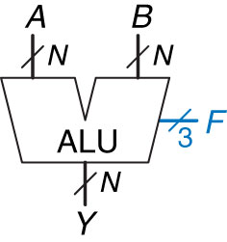
ALU – Block Diagram
ALU: Arithmetic Logic Unit
Combine Math and Logic
Heart of most computers
Has 7 functions
Figure 5.14 ALU symbol
Copyright © 2013 Elsevier Inc. All rights reserved.

Slide 4
ALU – Block Diagram
Build an ALU with logic Functions:
What do we need?
Adder
Inverter
And
Or
Mux
Comparator
Control Signals
F₂ | F₁ | F₀ | Function
0 | 0 | 0
0 | 0 | 1
0 | 1 | 0
0 | 1 | 1
1 | 0 | 0
1 | 0 | 1
1 | 1 | 0
1 | 1 | 1

Slide 5
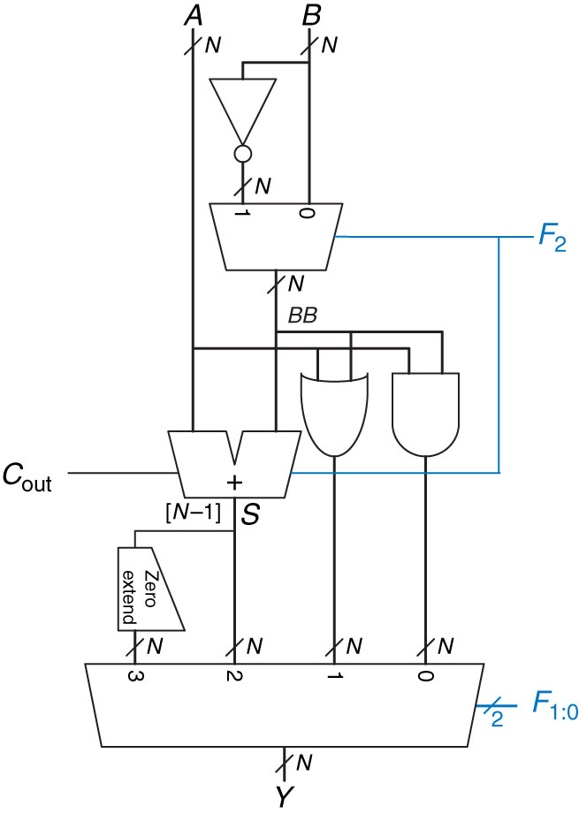
ALU
Figure 5.15 N-bit ALU

Slide 6
Multiplication in Binary
We’ve seen how an ALU can add and subtract in binary.
How do we multiply in Binary?
 |  | 1 | 0 | 1
 | X | 0 | 1 | 1 |  | X
 |  |  |  |  |  | ➔

Slide 7
Shifter
Shifter:
Logical – fill empty spots with 0’s
Arithmetic – when shifting right, fills empty spots with MSB (to preserve sign)
ASL is same as LSL

Slide 8
Rotator
Rotator:
Rotates in circles
# that falls off one end attaches to other end

Slide 9
Shamt
Shamt:
Shift Amount
Why is this useful?
Helps multiply and divide!

Slide 10
Examples
100110 ➔ Logical Shift Right ➔
What if it was an Arithmetic Shift Right on a signed number?
100110 ➔ Arithmetic Shift Right ➔
100110 ➔ Logical/Arithmetic Shift Left (6-Bit System) ➔
00100110 ➔ Logical/Arithmetic Shift Left (8-Bit System)➔

Slide 11

Practice
Practice:
Use Only two 2:1 mux to create a 3:1 mux:
$AB=00=>I_{0}$
$AB=01=>I_{1}$
$AB=1X=>I_{2}$

Slide 12
Quiz
Quiz: 5 Min
http://www.online-stopwatch.com/full-screen-stopwatch/

Slide 13
Extra Instruction (EI)
Maj Jeffrey Falkinburg
2E46E
Office: 333-9193
M1
ECE 281 – 2F44
T1
M2
ECE 281 – 2F44
T2
M3
ECE 463 – 2G2
T3
ECE 383 – 2E48A
M4
ECE 463 – 2G2
T4
ECE 383 – 2E48A
Available
M5
T5
Sometimes Available
M6
ECE 383 – 2E48A
T6
Always Unavailable
M7
ECE 383 – 2E48A
T7

Slide 14

14

